Slide 1
Team number
Our names and project idea

Slide 2
Statement of Purpose
Was to create an application and collection of games that are both fun as well as useful.
We want to strive for something that is visually appealing and with all the backend logic

Slide 3
Risks and Rabbit Holes

Slide 4
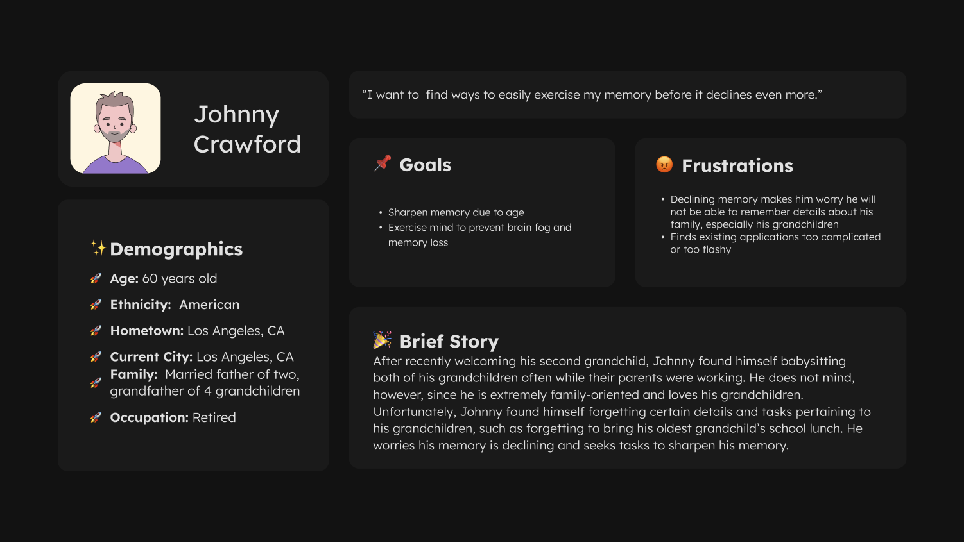
User Personas

Slide 5
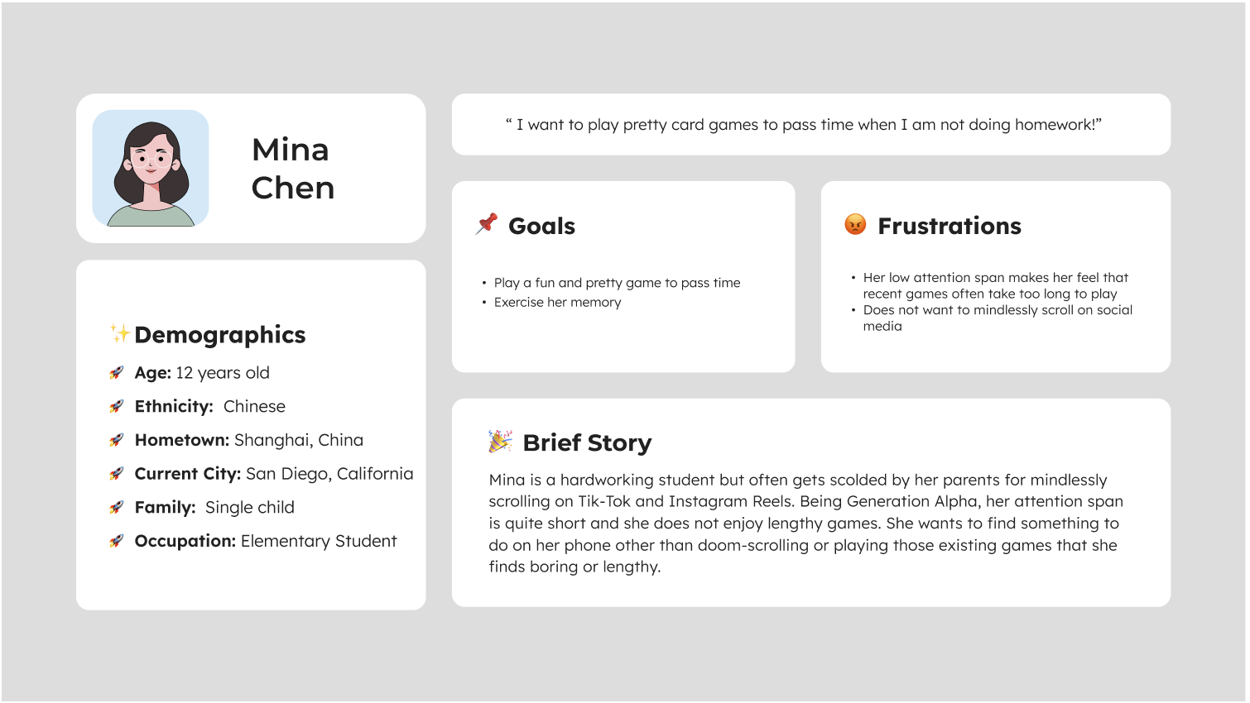
User Personas

Slide 6
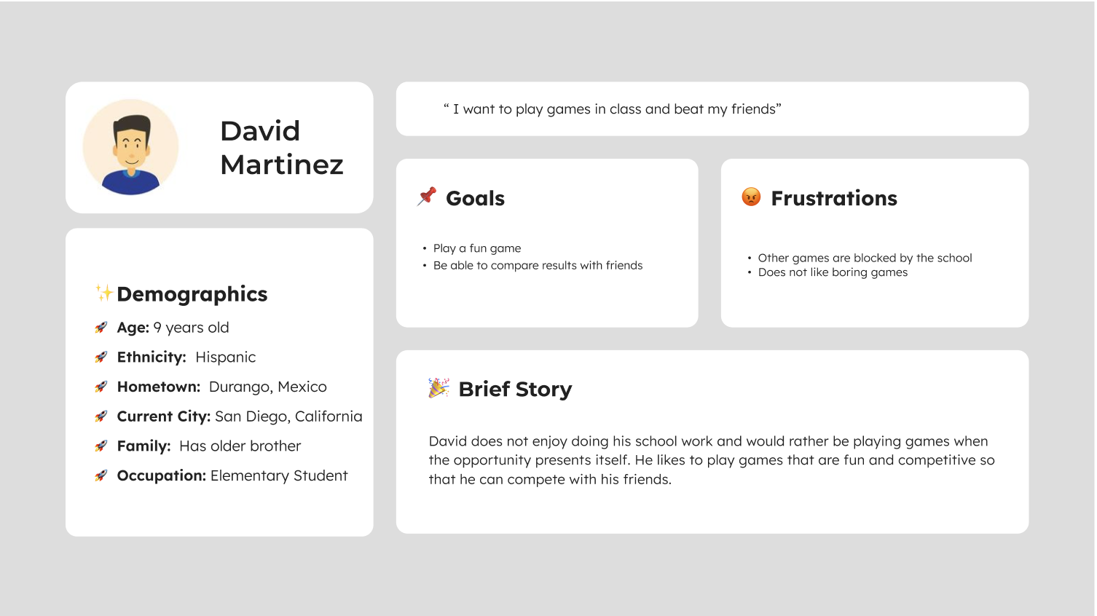
User Personas

Slide 7

User Personas

Slide 8
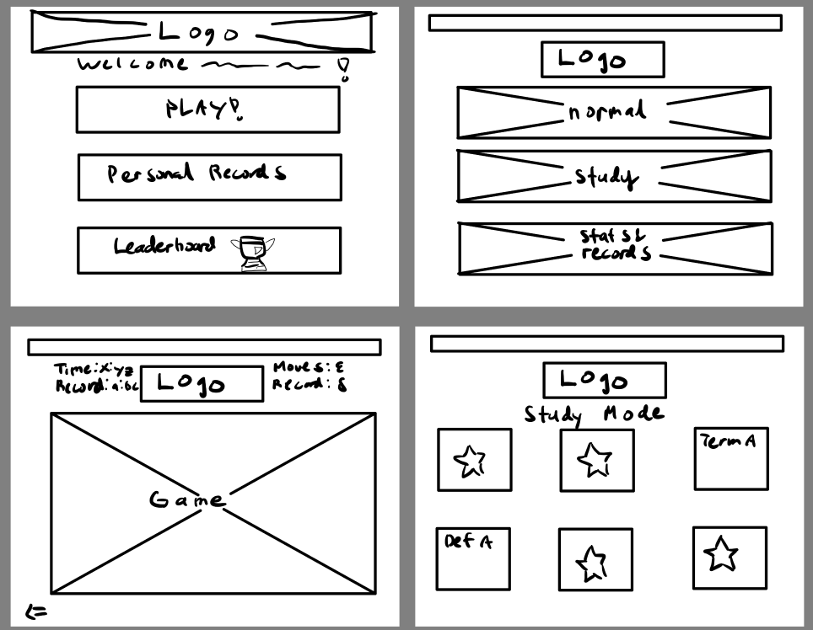
Wireframes

Slide 9
Wireframes

Slide 10
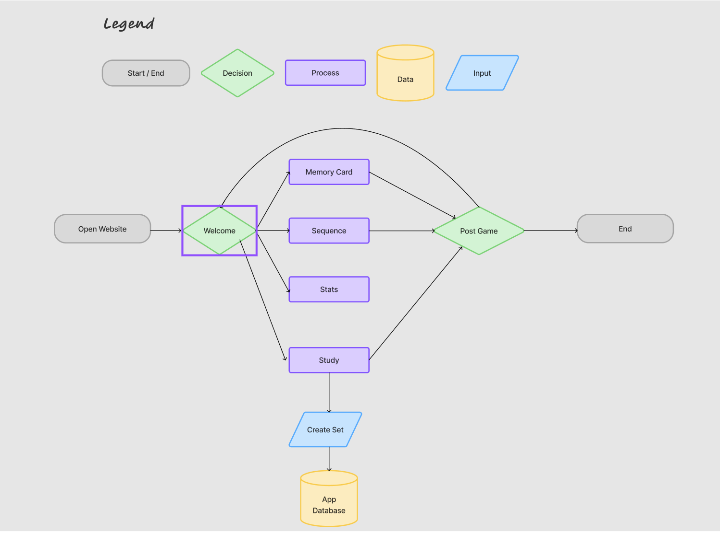
System Diagram

Slide 11
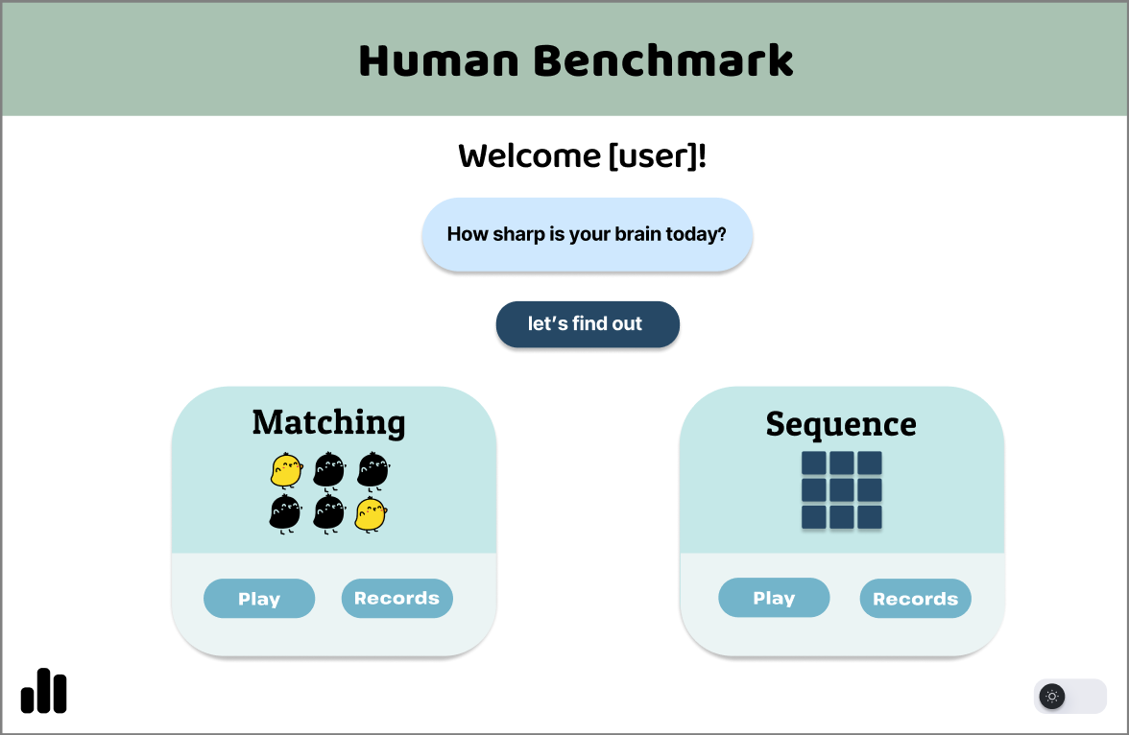
Visual Mock-Up: Homepage
Notes:
Point out leaderboards button as well as sequence

Slide 12
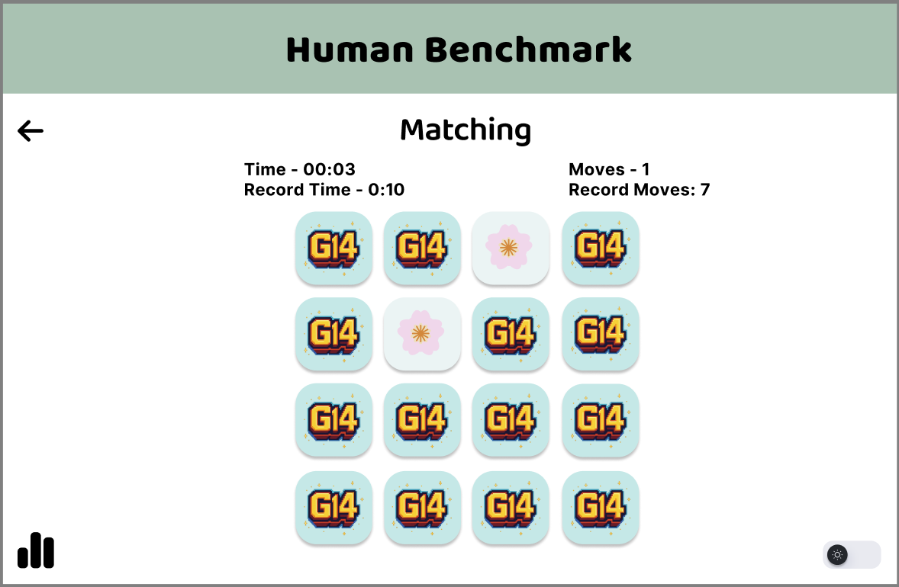
Visual Mock-Ups: Matching Game and features

Slide 13
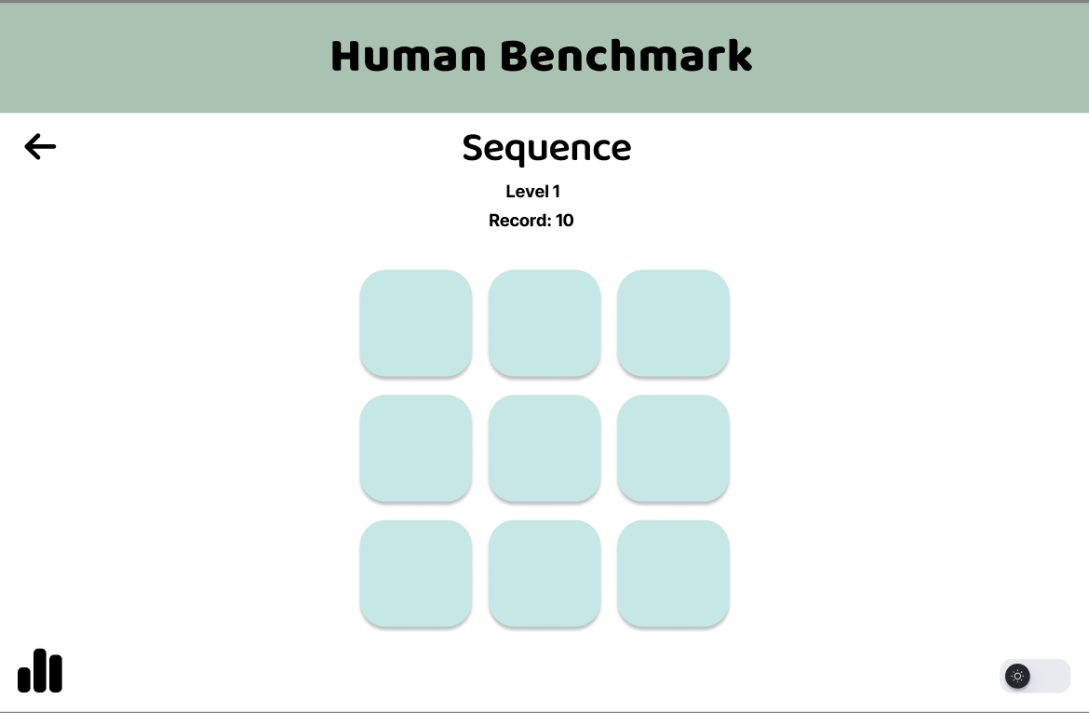
Visual Mock-Ups: Sequence memory game

Slide 14
Project Roadmap
In Depth planning and research
Figure out our base tech stack
Create homepage
Create working bare bones memory (matching) card game

